Slide 1
Sex,
Myths
and the
Menopause
Dr Marion Sloan Mb ChB, MRCP, FRCGP

Slide 2
Partner at Sloan Medical Centre
City-wide elected GP Board Member Sheffield CCG
GP on PCS Sexual Health Development group
Conflicts of Interest

Slide 3
Why is this important now?
World Menopause Day 18th October, 2021
Two new pieces of information.

Slide 4
EMAS - European Menopause
Andropause Society
EMAS 2021
global recommendations
menopause in the workplace
employers and managers
workplace environment more
menopause friendly
improve wellbeing
ability to remain in work

Slide 5
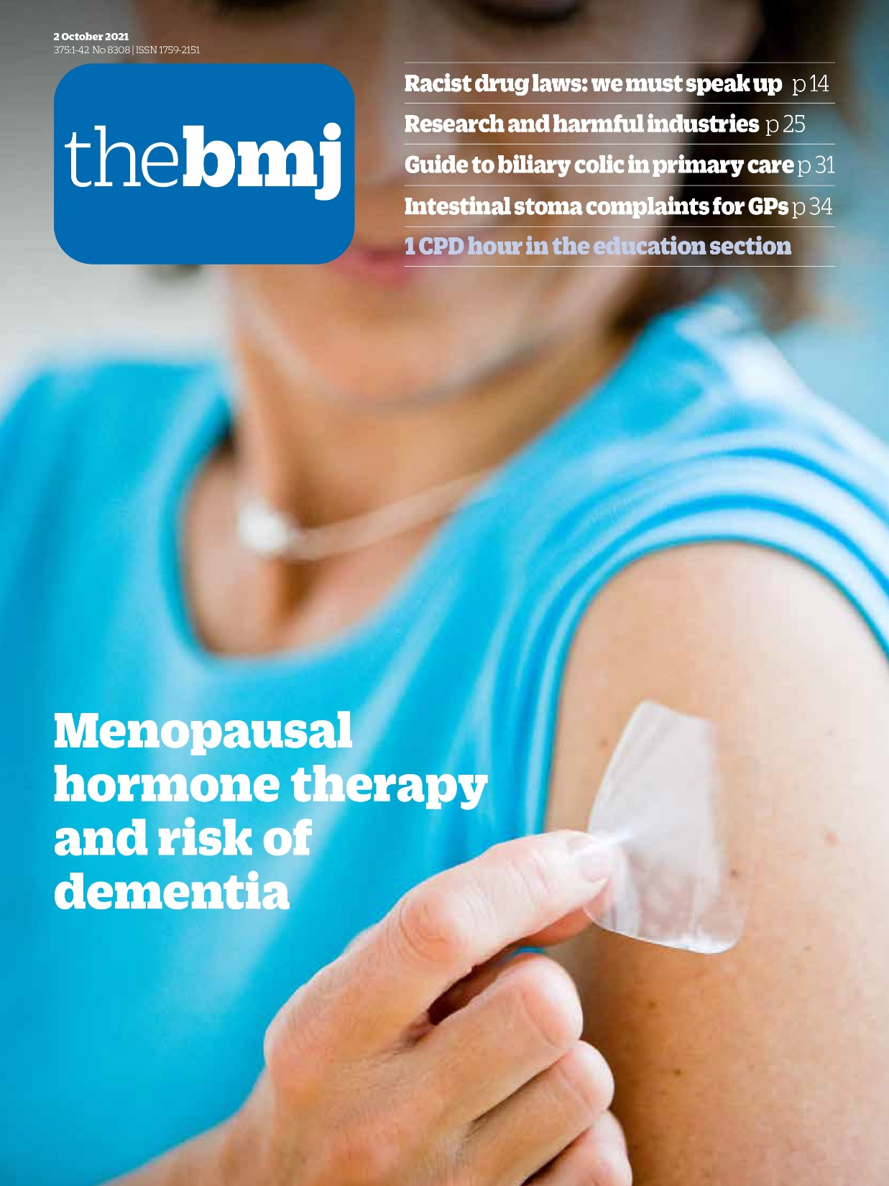
BMJ October 2021
HRT and Dementia
“What this study adds”
HRT for the menopause does not
increase the risk of dementia

Slide 6
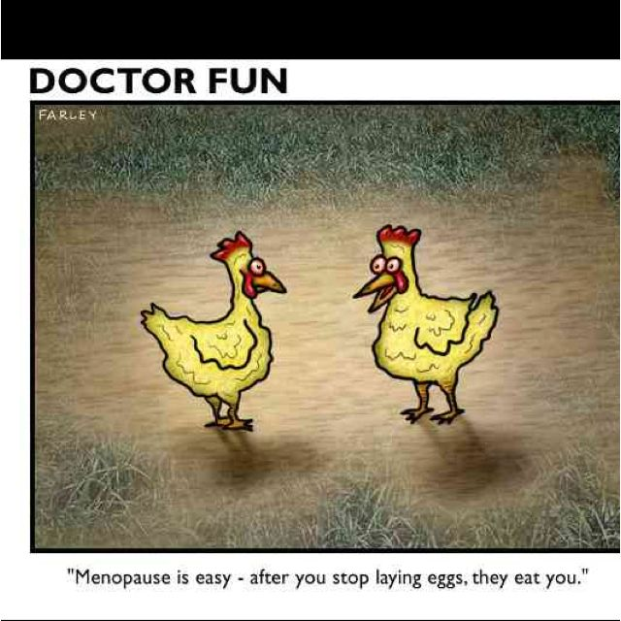
“Menopause is easy – after you stop laying eggs they eat you.”

Slide 7
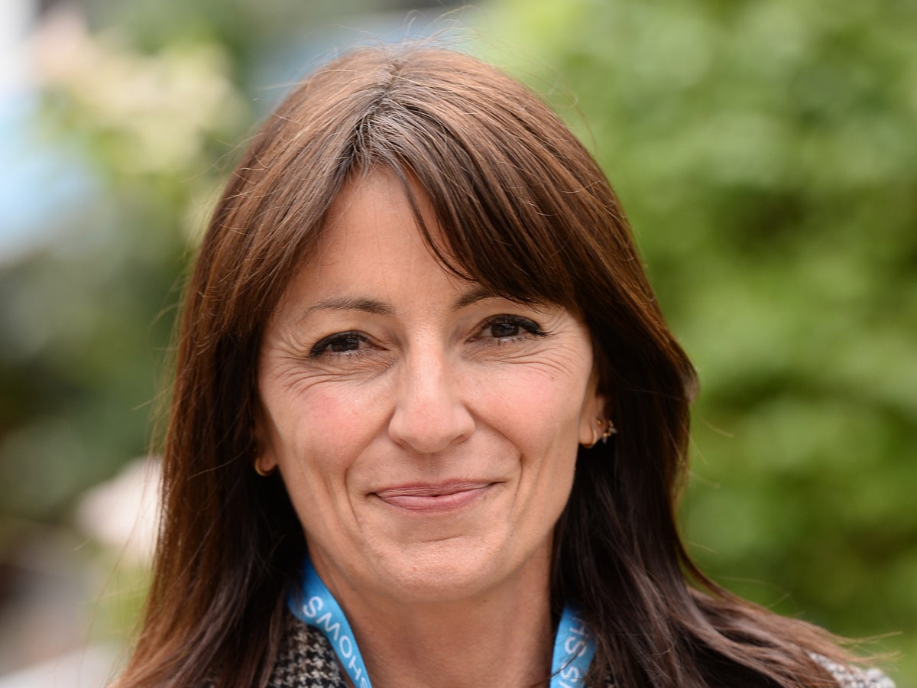

Slide 8
“I put my keys in the bin
and my phone in the fridge!”

Slide 9
51% of the population : half of their lives
Hormone deficiency
Mum is kingpin of the family
Women are a major part of the workforce
Sub-optimal health/sub-optimal productivity

Slide 10
NICE - Goal - 2020
HCP should be able to:
diagnose the menopause
recognise premature menopause
advise about lifestyle
be familiar with drugs including HRT
refer to specialist if appropriate

Slide 11
WHAT IS HAPPENING?
Loss of ovarian reserve
Oestrogen
Testosterone
Or
No

Slide 12
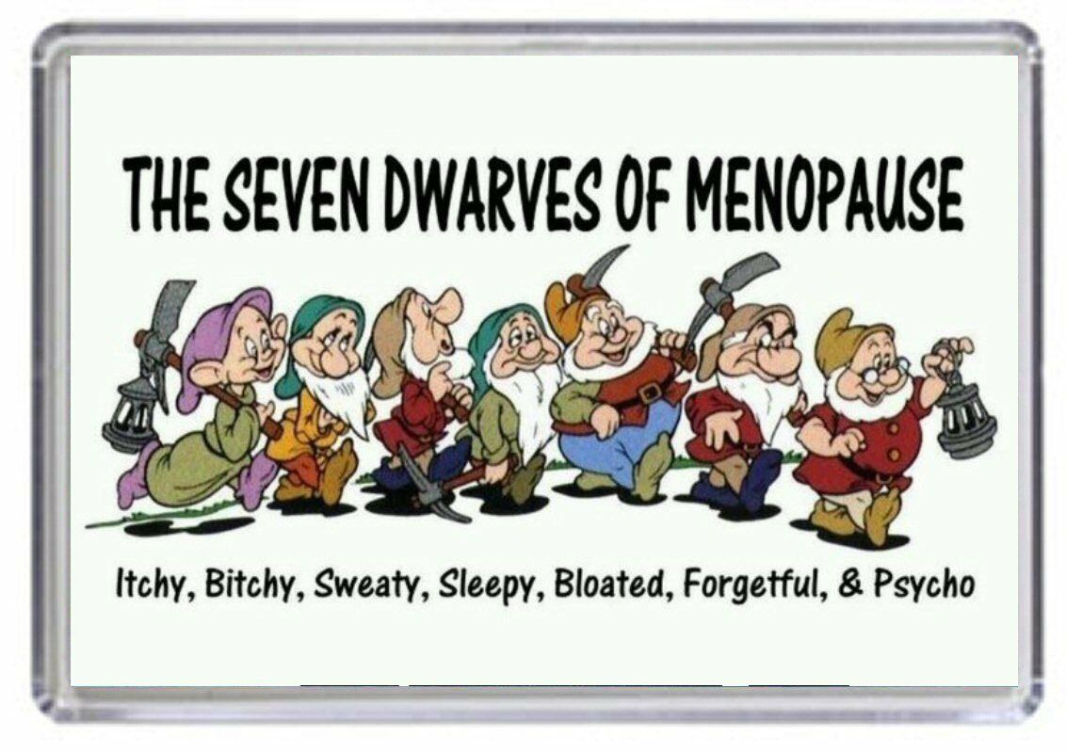

Slide 13
SYMPTOMS
Vaginal dryness
Fatigue
Incontinence
Weight gain
Flushes
Bloating
Heavy periods
Sweats
Memory problems
Poor sleep
Brain fog
Aching joints
Panic attacks
TATT
Tender breasts
Low mood
Palpitations
Osteoporosis
Brittle nails
Itchy skin
Headaches
Bladder weakness
Free-floating anxiety
Skin change
Hair loss
Painful sex
Irregular periods
Mood swings
Instability
Cystitis
Insects crawling over the skin

Slide 14
But
“My friend says it gives you
cancer and blood clots”

Slide 15
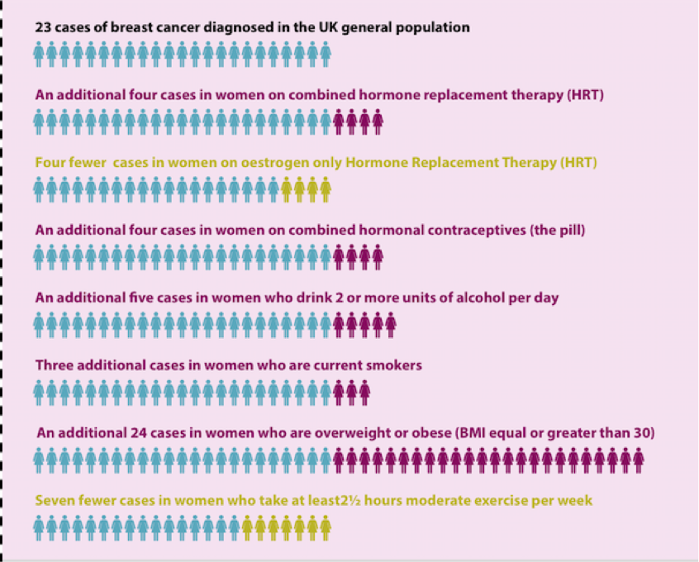

Slide 16
Health Benefits
Cardiovascular
Mood
Bones
Dementia
improves cholesterol +
lipids
lifts depression
slows rate of development
of osteoporosis
Not increased

Slide 17
Where do we go with this?
Health Care Pprofesional role is to give information: NICE Goal
My friend says I need a blood test
Suggest read “Rock my Menopause”
Maybe watch Davina on YouTube
Informed choice individual risks and benefits
HCP support – guide – next steps

Slide 18
If hysterectomy
If uterus
Natural hormones
Oestrogen
Progesterone
oestrogen only
oestrogen + progesterone
body identical – made
from yam
transdermal – no increase
in blood clots
utrogestan capsules
oral/vaginal
Mirena coil – GP or sexual
health

Slide 19
Genito-urinary Syndrome of the menopause
Dyspareunia
Recurring urinary tract infections
Vaginal discharge
Atrophic vaginitis
Ovestin cream
Blissell cream
Vagifem pessaries
Intrarosa pessaries : prasterone: DHEA

Slide 20
K
I
S
S
(Keep It Simple, Sister)

Slide 21
Transdermal HRT
NOT associated with raised BP
NOT associated with blood clots
NOT contra-indicated in migraine

Slide 22
What checks are needed and how often?
Good practice anyway
Suggest checks: at the start / 3/12 / annually
Proforma
Ht. Wt. BP. smoking . DVT.
Personal or FH cancer of the breast
Active liver disease
Clotting disorders
Smear
Mammogram

Slide 23
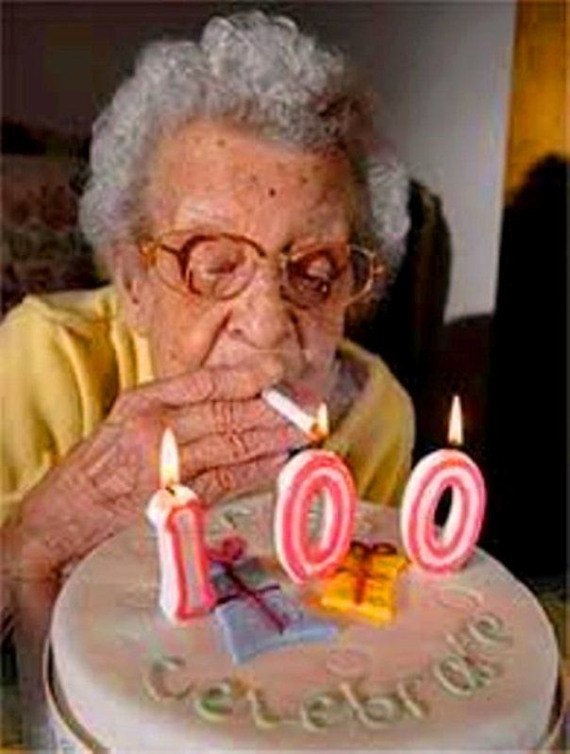
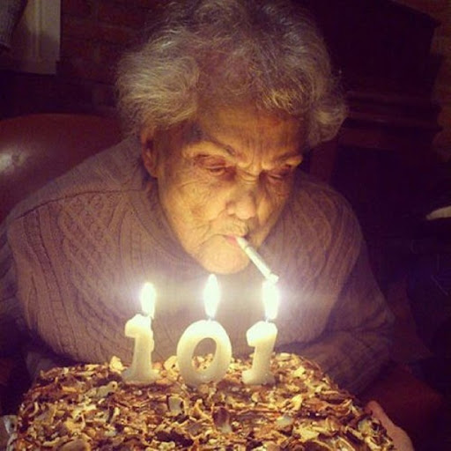
WHEN IS IT TIME TO STOP?

Slide 24
SUMMARY
HRT is safe
No increased death rate
Improve quality of life for women
Our role as HCP is to support informed
choice

Slide 25
H
R
T

Slide 26

usband
H
R
T
eplacement
herapy

